Slide 1

Temporal and Spatial Perspectives on the Fate of Anthropogenic Carbon
A Carbon Cycle Slide Deck for Broad Audiences
Contributors:
Data sets: Samar Khatiwala (University of Oxford), Tim DeVries (Univ. California, Santa Barbara)
Animations: Jack Cook (Woods Hole Oceanographic Inst.)
Development and coordination: Galen McKinley (Univ. Wisconsin - Madison), Craig Carlson (Univ. California, Santa Barbara), Heather Benway (Woods Hole Oceanographic Inst.)
Notes:
This slide deck was developed to inform broader scientific, as well as general audiences about the role of the ocean in the global carbon cycle, including key sinks and sources of anthropogenic carbon and how they have evolved through time and space.

Slide 2
Bar Chart Animations of Anthropogenic Carbon
Sinks and Sources Through Time (2 versions)

Slide 3
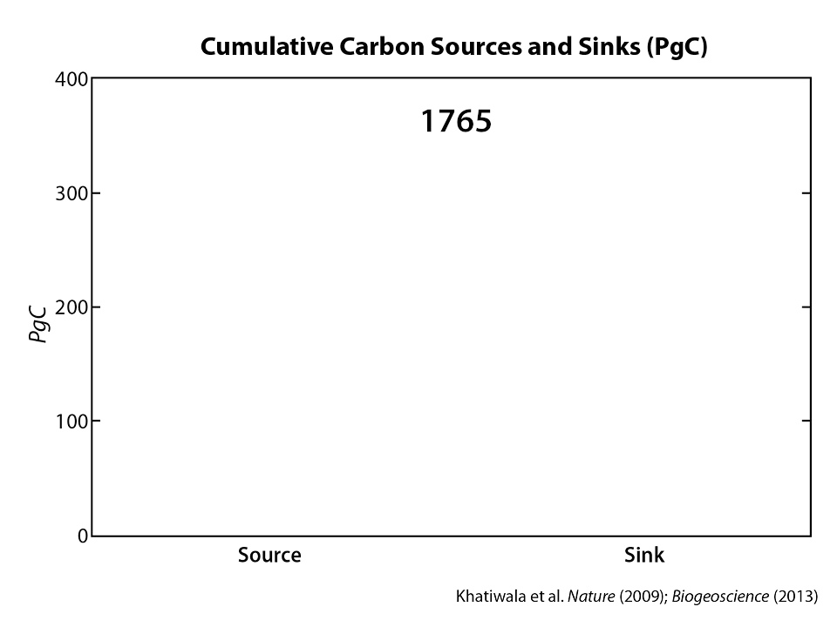
Khatiwala et al. Nature (2009), Biogeosciences (2013)
Notes:
Full time interval (1765-2011) (49 seconds)

Slide 4
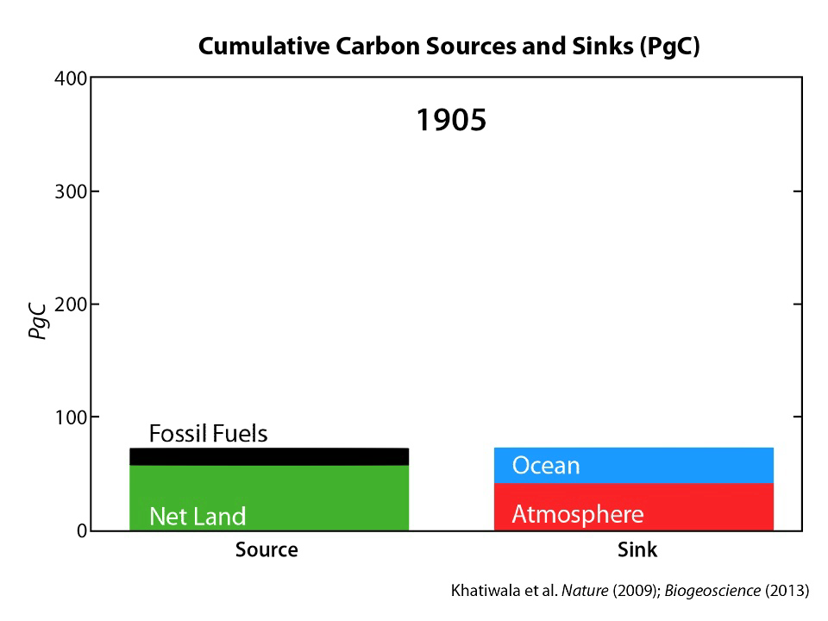
Khatiwala et al. Nature (2009), Biogeosciences (2013)
Notes:
Abbreviated time interval (1905-2011) (22 seconds)

Slide 5
Line Plot Animations of Anthropogenic Carbon
Sinks and Sources Through Time (2 versions)

Slide 6
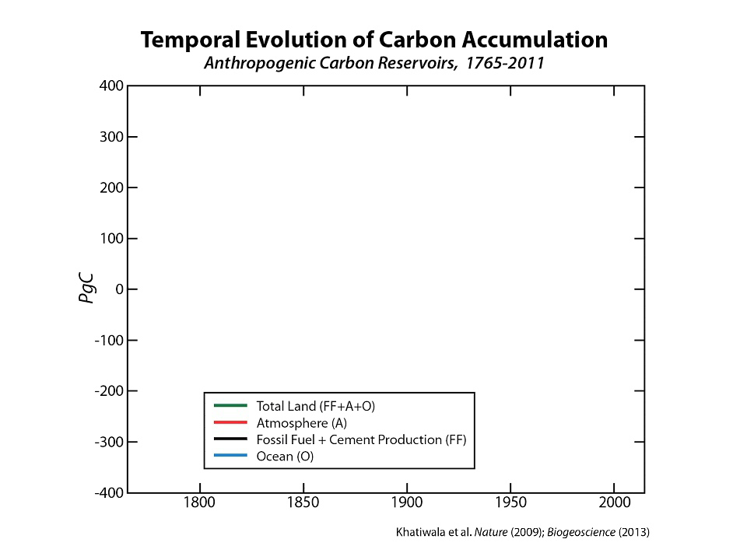
Khatiwala et al. Nature (2009), Biogeosciences (2013)
Notes:
Animate one line (reservoir) at a time (17 seconds)

Slide 7
Khatiwala et al. Nature (2009), Biogeosciences (2013)
Notes:
Animate all lines (reservoirs) at the same time (10 seconds)

Slide 8
Map Animation of Anthropogenic Carbon
Distribution in Ocean Through Time

Slide 9
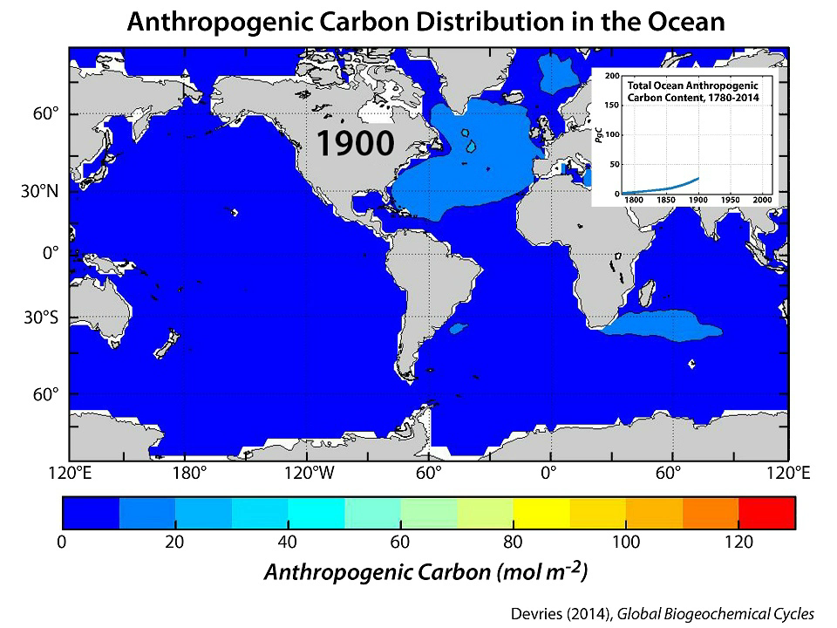
DeVries (2014), Global Biogeochemical Cycles
Notes:
This slide shows us where the anthropogenic carbon is stored in the ocean and how that has changed through time.
1900-2014 (24 seconds)

Slide 10
Map Animation of Cumulative Air-Sea Flux of Anthropogenic Carbon Through Time

Slide 11
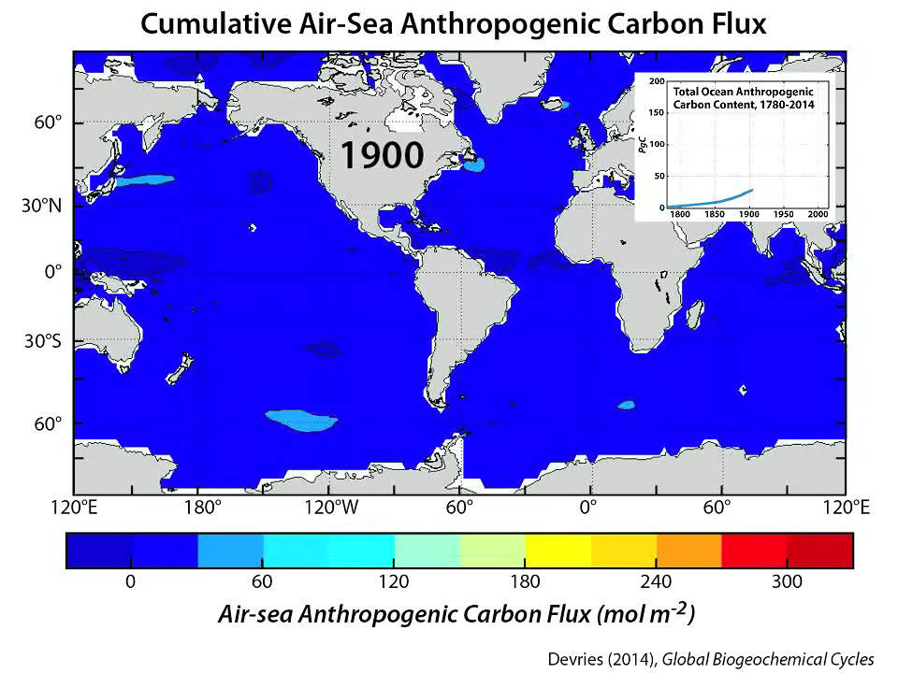
DeVries (2014), Global Biogeochemical Cycles
Notes:
This slide shows us where the anthropogenic carbon is entering the ocean (positive values indicate flux from the atmosphere into the ocean) and how that has changed over time.
1900-2014 (24 seconds)

Slide 12
References
Khatiwala, S., F. Primeau, T. Hall (2009). Reconstruction of the history of anthropogenic CO₂ concentrations in the ocean. Nature 462, doi:10.1038/nature08526.
Khatiwala, S., T. Tanhua, S. Mikaloff Fletcher, M. Gerber, S. C. Doney, H. D. Graven, N. Gruber, G. A. McKinley, A. Murata, A. F. Rios, C. L. Sabine (2013). Global ocean storage of anthropogenic carbon. Biogeosciences 10, 2169-2191, doi:10.5194/bg-10-2169-2013.
DeVries, T. (2014). The oceanic anthropogenic CO₂ sink: Storage, air-sea fluxes, and transports over the industrial era., Global Biogeochemical Cycles 28, 631-647, doi:10.1002/2013GB004739.

Slide 13
Suggested Citation
Ocean Carbon and Biogeochemistry Program (2015). Temporal and Spatial Perspectives on the Fate of Anthropogenic Carbon: A Carbon Cycle Slide Deck for Broad Audiences. Contributors: S. Khatiwala, T. DeVries, J. Cook, G. McKinley, C. Carlson, H. Benway.
doi: 10.1575/1912/7670

