Slide 1
East (Atlantic) Coast breakout report
Leader: Wei-Jun Cai
Rapporteur: Kevin Kroeger
~10 people

Slide 2
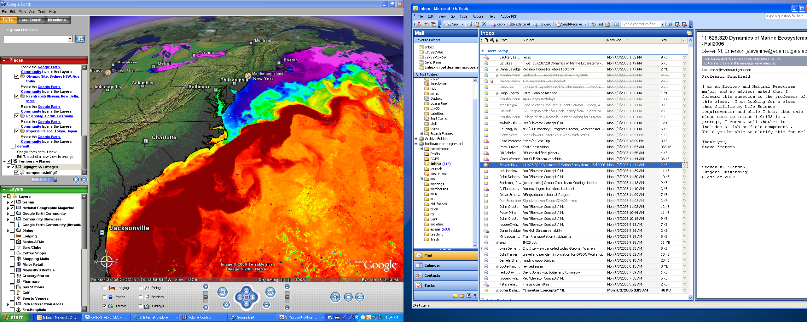
Study domain
GoM = Gulf of Maine
MAB = Mid-Atlantic Bight
SAB = South Atlantic Bight
S. Signorini

Slide 3
Important Questions
• What data sets are readily available? What is the quality of the data sets?
• What projects are coming on-line that will provide important data in the near future?
• What kinds of numerical models exist (Box vs. 1D vs. 3D)? Spatial resolution? What processes do these include (physics only? ecosystem? carbon?)?
• What advances have been made since the 2008 NACM report?

Slide 4
What data sets are readily available? What is the quality of the data sets?
A. Coastal Ocean Observing Networks
B. Coastal and land-based measurements of atmospheric fluxes
C. River Observations
D. Satellite Observations
E. Field experiments
F. Lab experiments
Notes:
D. Satellite Observations

Slide 5
A. Coastal Ocean Observing Networks
    Cruises
    Moorings
    VOS

Slide 6
What projects are coming on-line that will provide important data in the near future?

Slide 7
What kinds of numerical models exist (Box vs. 1D vs. 3D)? Spatial resolution? What processes do these include (physics only? ecosystem? carbon?)?

Slide 8
What advances have been made since the 2008 NACM report?
New CO2 data with good spatial and time coverage in Gulf of Maine
New CO2 data with better spatial and time coverage in SAB
High resolution and long term Coastal CO2 mooring data
Modelers and field workers are forming various groups to work together.
Develop regional budgets (Najjar, Coble, other areas)

Slide 9
concerns
Discussion of whether listing data sets on spreadsheet implies it is available.
Discussion on how to move synthesis activities forward including funding agency supports.
New shelf CO2 measurements?
Land input (C, Nutrients,…)
Eddy covariance flux towers (estuarine/wetland)
Lab exp to better determine CO2 dissociation constants in high DOM estuarine waters.
Better standard and method for coastal pH measurements

